Slide 1
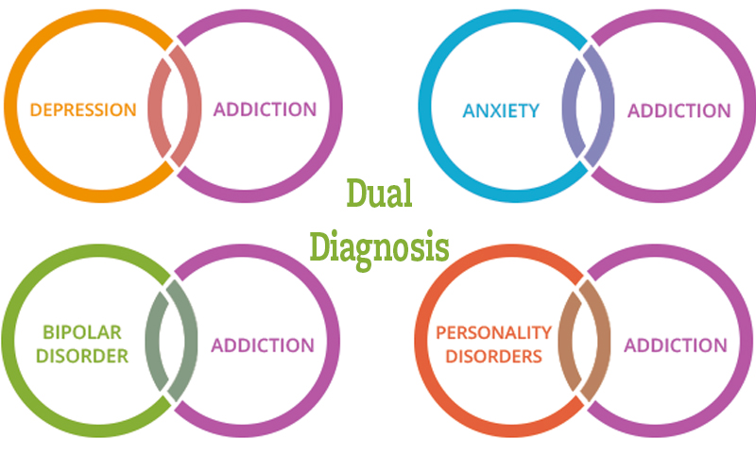

DDX
Kim Arrington, M.Ed., LPC
CEO /Clinical Director
Woodlands Recovery Centers – Beaumont
(Copyright KiMowana Inc 2021)

Slide 2
Objectives of this Training
Multidisciplinary Team Awareness
Overview of Statistics Prevalence of DDX
Addiction as a Disease of the Reward Pathway
Highlights of Diagnosis for Common MH and SUD
Symptoms and Behaviors that mimic drug use and MH Symptoms
First lets define some things
  Multidisciplinary Team Approach
  Dual Diagnosis
  Addiction
  Diagnostic Criteria - Clinical Bipolar, Depression, & Anxiety

Slide 3
What is a Collaborative
Multidisciplinary Team Approach
MH Teams
SUD Teams
Legal Resources
Therapy resources
Psychiatric resources
Medical Resources
Community Resources
Support teams
  Peers
  Families
  Church groups/hobby groups
  Other social Supports
Recovery Coaches, Treatment providers
Basically, ANYONE involved in the person’s life…..

Slide 4
Collaborative
Multidisciplinary Team Approach
Clinical Awareness of Medications , drugs, effects, diagnosis's and interactions.
MH teams being aware that in initial phases of SUD recovery, clients behavior and report sound like all kinds of diagnostic symptoms
SUD teams being aware that MH symptoms are actually present and exacerbated by abstinence and MUST collaborate with the MH provider about the person’s history and needs
All Providers are working with the self report of the client!
  Alcohol and Drug use warps perception of reality and processing of information as it is happening
  Blackouts are same as an amnesia episode, only the memory doesn’t come back for event or situation
  Normal daily routines as well as big events that happen while person using, or within 24 hours of use aren’t recorded and logged in memory bank in concrete terms

Slide 5
“If the only tool
you have is a
hammer, you tend
to see every
problem as a nail.”
(Abraham Maslow)
Are we often too quick to judge based on past experience?

Slide 6
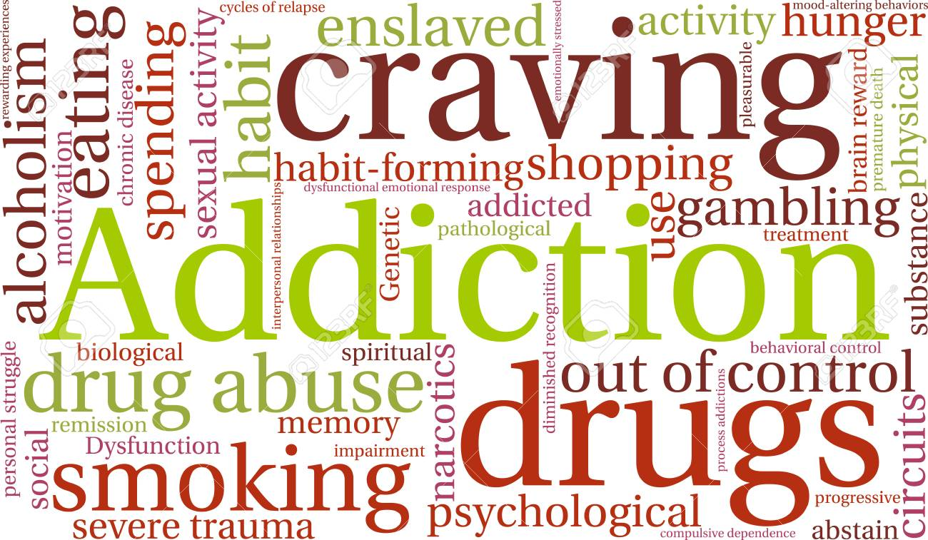
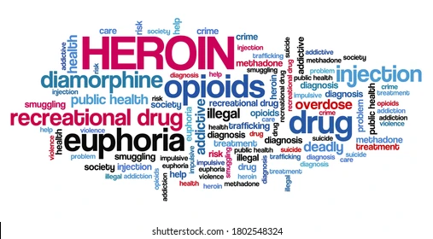

Are We are treating the same Symptoms just a different disease process ?

Slide 7

Dual Diagnosis Defined
When a patient presents with symptoms of both a substance abuse disorder and a mental health disorder, they are living with a Dual Diagnosis.
The pair of issues can be comprised of any combination (e.g., alcoholism and depression, painkiller dependence and anxiety disorder, marijuana addiction and bipolar disorder, etc.) and in most cases, the symptoms and issues related to one can worsen the issues of the other.

Slide 8
DualDiagnosis.org Statistics
Estimated about 17.5 million Americans over the age of 18 (or 8 percent of the adult population) had a serious mental health disorder in the past year. Of these, about 4 million people also struggled with a co-occurring drug or alcohol dependency.
That’s 22% of those 17.5 million have a Dual Diagnosis
In the span of six years, the percentage of patients in drug rehab also diagnosed with a co-occurring mental health disorder increased from 12 percent to 16 percent.
Alcohol is the primary substance of abuse for 45 percent of Dual Diagnosis patients and 38 percent of all other substance-abusing patients
Age of 18 and 25 years old
  More than 38 % of Dual Diagnosis
  17% percent of patients diagnosed with only a mental health disorder

Slide 9
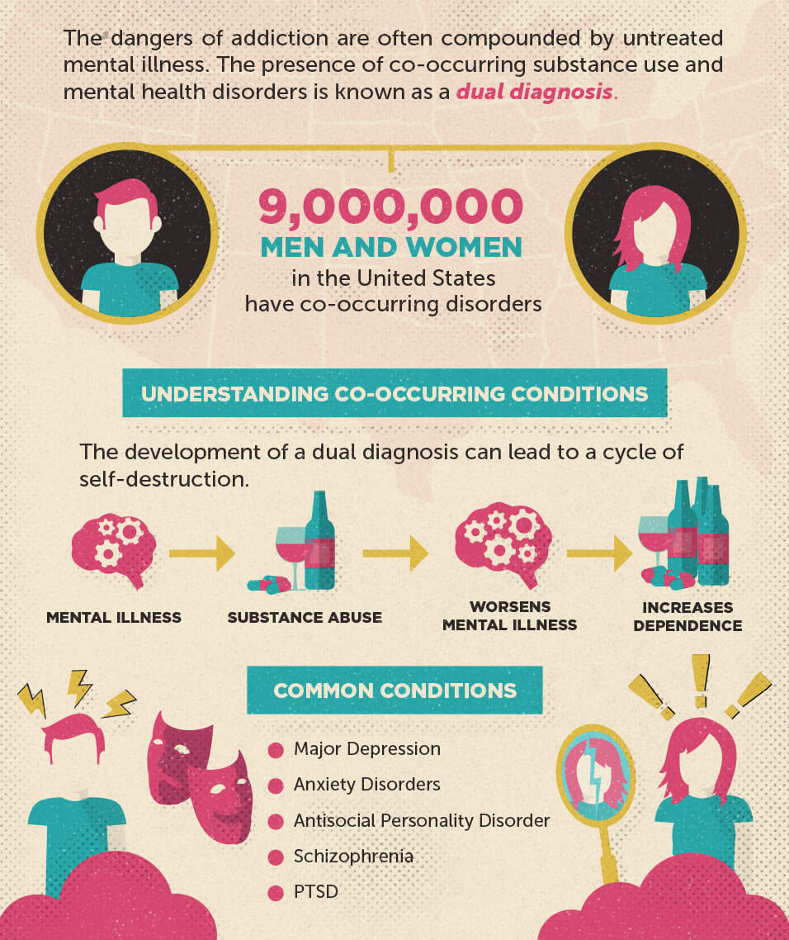
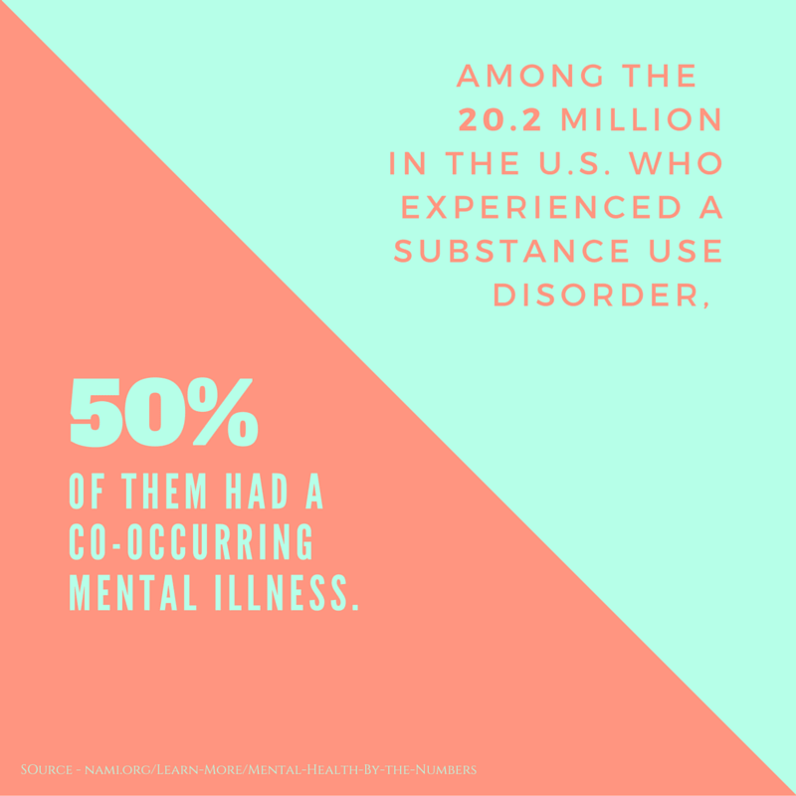
Its Everywhere
But no one really knows stats
NAMI 2018

Slide 10
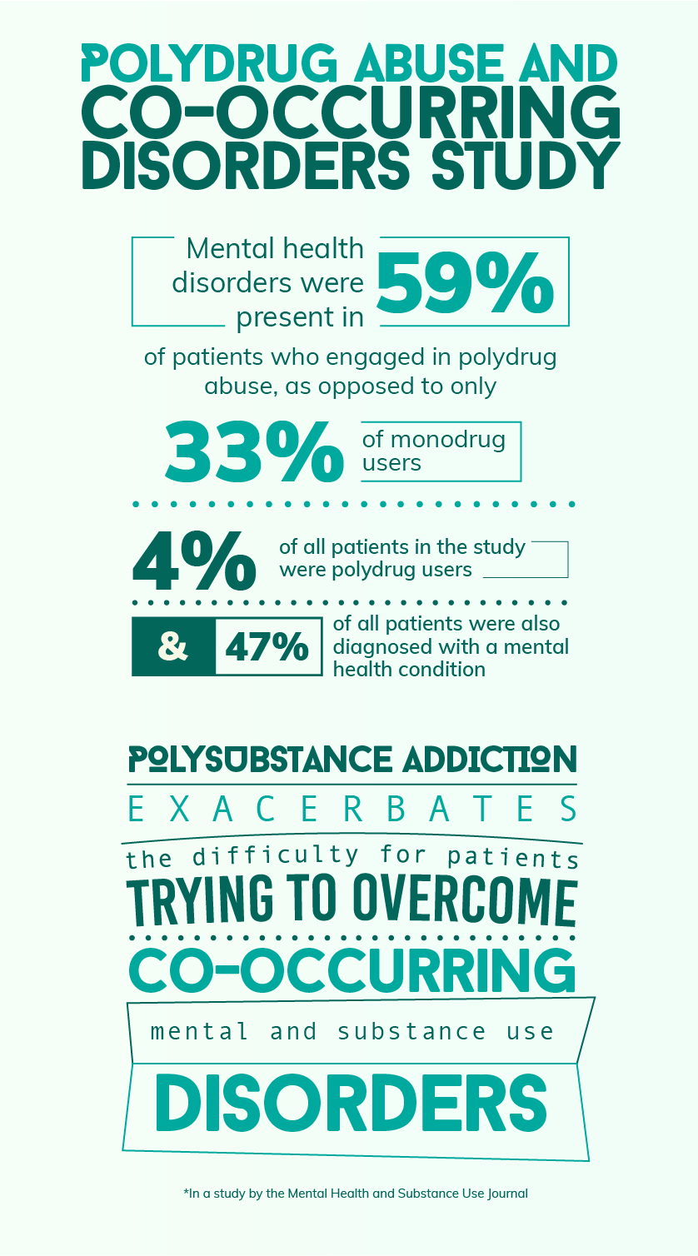
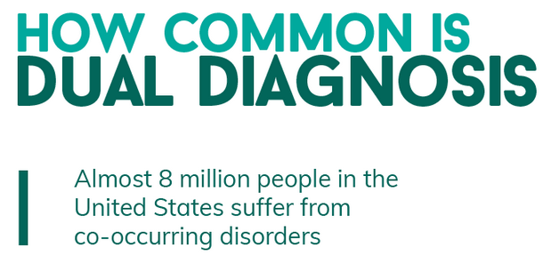
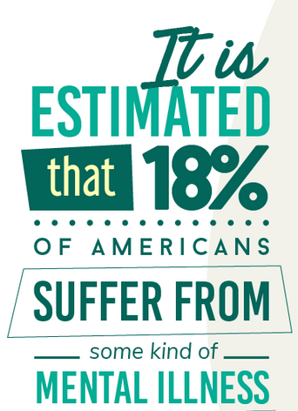
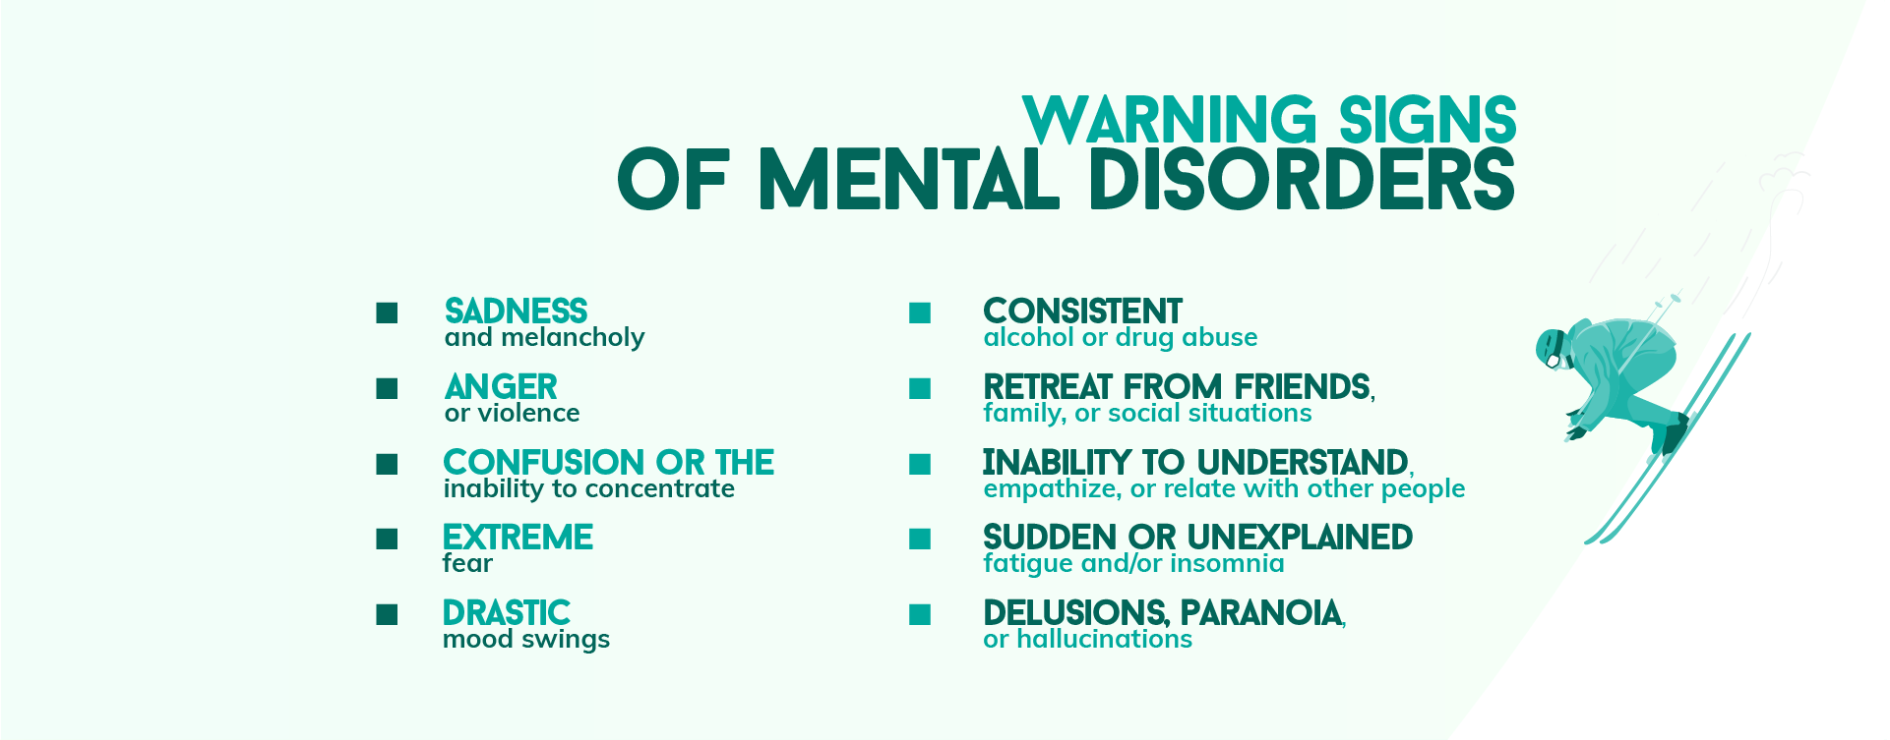
Info on web can be confusing
?

Slide 11
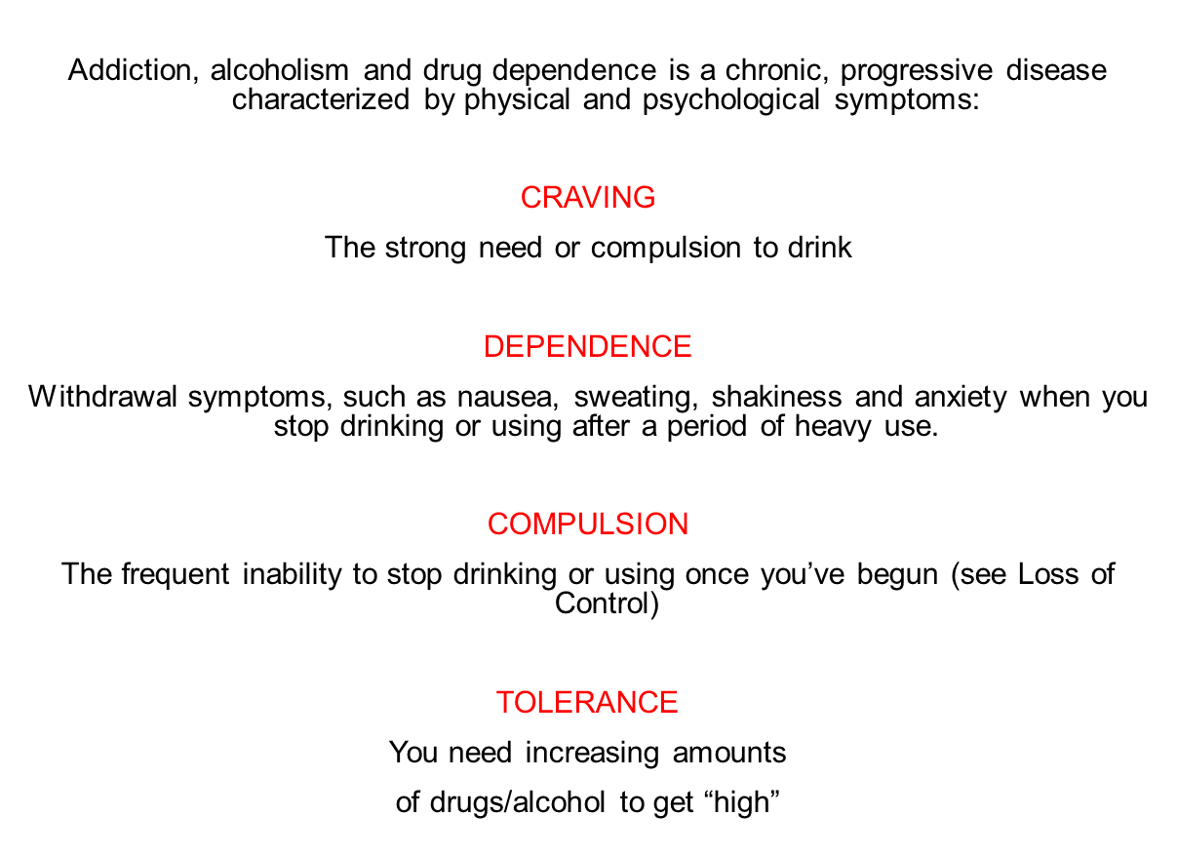
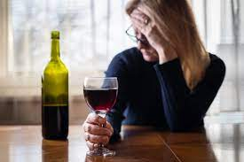
Definition of addiction
“Alcoholism is a primary, chronic disease with genetic, psychosocial and environmental factors influencing its development and manifestations. The disease is often progressive and fatal.
It is characterized by continuous or periodic impaired control over drinking, preoccupation with the drug alcohol, use of alcohol despite adverse consequences, and distortions in thinking, most notably denial.”
(National Council on Alcoholism and Drug Dependence, Inc. 2/3/90)

Slide 12
ASAM (American Society of Addiction Medicine)
Addiction is a primary, chronic disease of brain reward, motivation, memory and related circuitry. Dysfunction in these circuits leads to characteristic biological, psychological, social and spiritual manifestations. This is reflected in an individual pathologically pursuing reward and/or relief by substance use and other behaviors.
Addiction is characterized by inability to consistently abstain, impairment in behavioral control, craving, diminished recognition of significant problems with one’s behaviors and interpersonal relationships, and a dysfunctional emotional response. Like other chronic diseases, addiction often involves cycles of relapse and remission. Without treatment or engagement in recovery activities, addiction is progressive and can result in disability or premature death.

Slide 13
Definition of a Disease
To be defined as a disease by the AMA a condition needs to be:
Chronic
Demonstrate a Progressive course over time
Terminal
Ongoing treatment and no Cure
If addiction was a mere Substance problem, then removal of the substance would be the solution. But we all can attest that is simply Not the case
Recovery is about Staying Stopped.
Human body does Not return to baseline once abstinence has been established. Actually stops at that point. Hence the saying and the science, a person picks up where they left off.

Slide 14
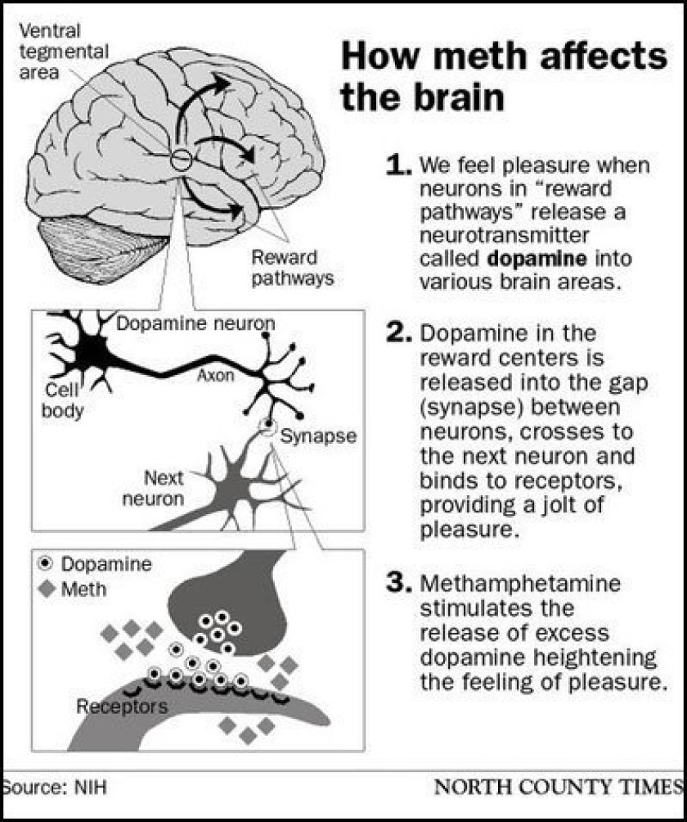
Disease?
Generally accepted now that Addiction IS a disease.
One simple reason?
Humans are Unable to override Neurology and Metabolism through cognitive choice or execution of Will Power

Slide 15
Addiction as a Disease of Reward Pathway
Addiction may start from an emotional or psychological trigger
If the purpose of the use results in Boost to Dopamine and overall reaction of the Reward Pathway in the Brain, then addiction has action potential
IF addiction is in place
  Satiation Center doesn’t work and ultimately the survival control center stops communicating properly
  Literally short circuited and person does, says things that are contrary to rational behavior and even their own belief system
  Unable to override this short circuited system through exertion of will power or choice
  Humans are Unable to override Neurology and Metabolism through cognitive choice or execution of Will Power

Slide 16
Addiction as a Disease of Reward Pathway
We Can’t change Neurology once a chemical reaction is in place.
Especially one that is powerful enough to override survival and normal satiation center.
We Can’t Change Metabolism either
Another Look: The 12-step process refers to Powerlessness.
This is often misunderstood and rarely discussed in its entirety
Reference to Allergy, abnormal reaction, perfectly capable, successful and competent men who were unable to control their reaction to alcohol once it had been consumed.
Refers to a person’s inability to stop using from a self will decision and choice. It literally applies to being unable to change my metabolism and my neurology

Slide 17
Hallmark characteristics of SUD
Selfishness – Driven by compulsion
Baffling – In face of serious consequences seem unable to change
Manipulation
Delusion Vs Denial
External Damage is MUCH worse than a MH disorder on its own
Loss of kids, marriage, employment
Legal problems
Car wrecks and injuries
Medical problems – the list is endless
Recurring Financial problems
Loss of home
Loss of Freedom
First Use
Experiment or
Relief of Emotional Trigger
Relief of symptoms
Genetics
Availability
Environment
Propensity for Addiction
Neurological changes
Metabolic Changes
No Ability to Choose based on Will Poser or Thought
Addiction

Slide 18
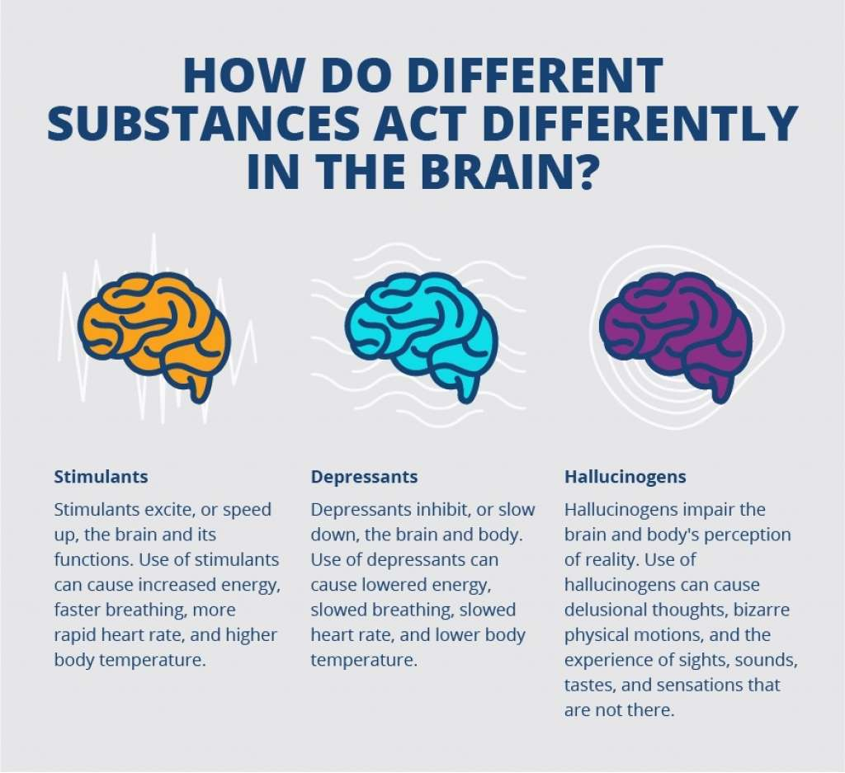
Basic Effects
Its all about the body and the brain
When you are looking for effects, we don’t ask about specific behavior because that varies.
Ex:Cocaine addiction isn’t identified by “did you pawn your children’s toys at Christmas, but those of us with some experience understand that behavior generally is associated with Crack addiction, but not always and not exclusive.
But when heart is racing, mind is racing, high energy, runny nose, elevated mood is present, then we know its Stimulants.

Slide 19
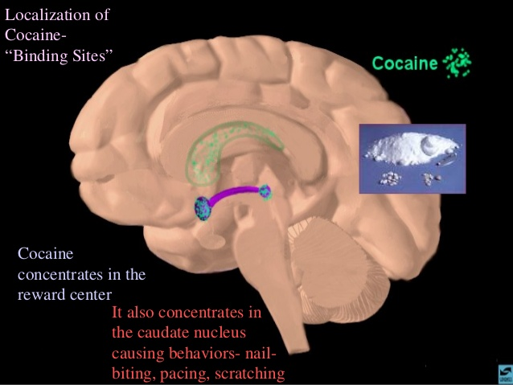
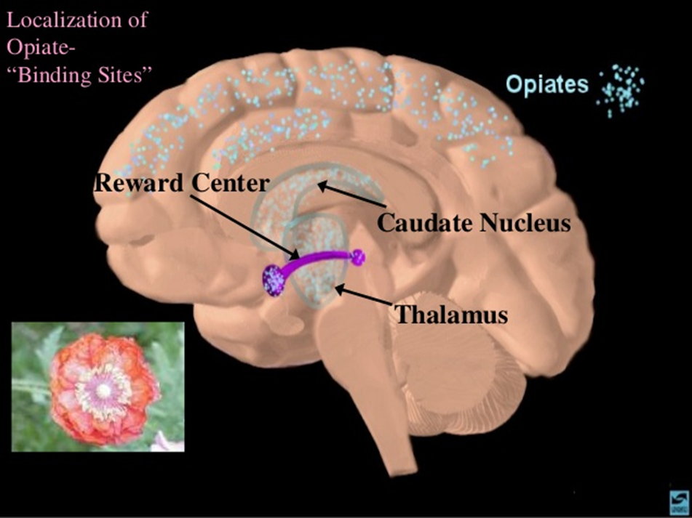
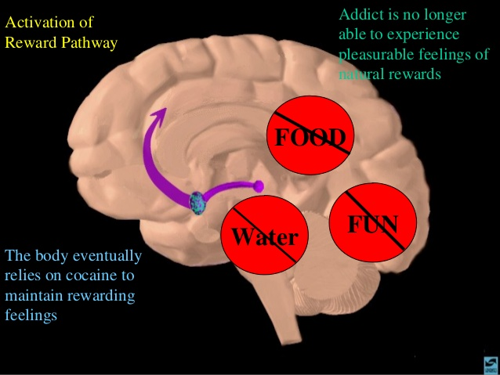
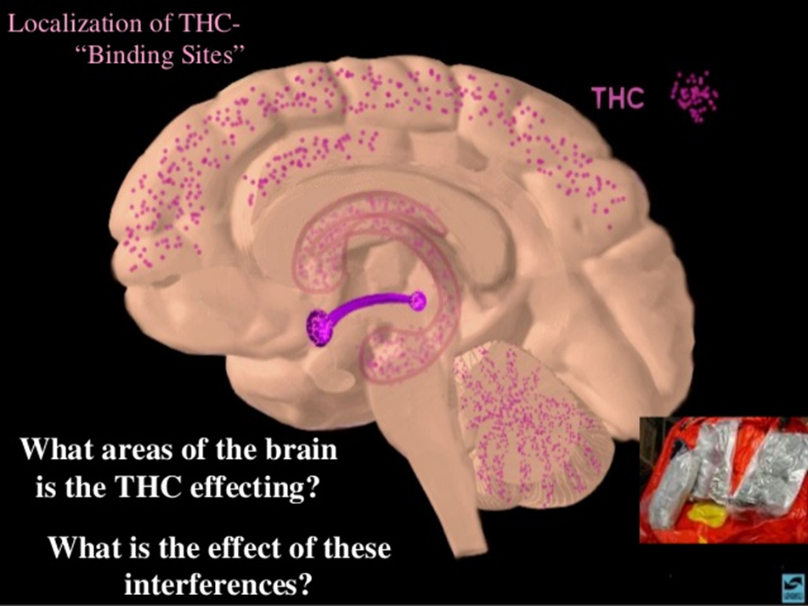

Slide 20


Opiates
THC

Slide 21
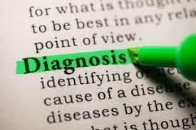
What is it and what’s the Purpose ?
Informs Treatment Team and provides Direction
Unable to treat without a diagnosis (protocols, billing etc)
Criteria provide parameters and descriptions of symptomology
Difficulty with SUD clients is that accurate diagnosis Relies on Accurate Self Report
  Interviewing skills

Slide 22
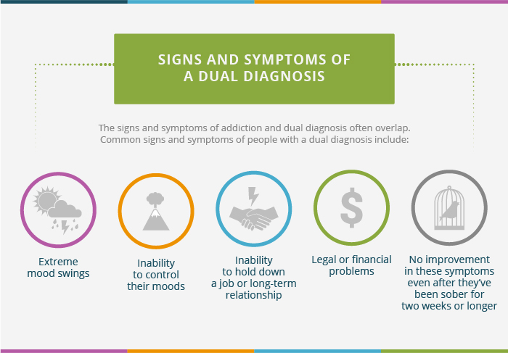
Diagnosis Criteria
All Criteria is Set by
DSM V
ASAM
TDI
ICD-10
At time of admission to any level of care for SUD the evidence of the criteria is listed in the admission.

Slide 23
SUD Diagnosis
DSM-5 Substance Use Disorder Criteria
1. Use in larger amounts or longer than intended
2. Desire or unsuccessful effort to cut down
3. Great deal of time using or recovering
4. Craving or strong urge to use
5. Role obligation failure
6. Continued use despite social/interpersonal problems
7. Sacrificing activities to use or because of use
8. Use in situations where it is hazardous
9. Continued use despite knowledge of having a physical or psychological problem caused or exacerbated by use
10. Tolerance
11. Withdrawal
Final formulation has three diagnostic categories:
Mild (2-3),
Moderate (4-5),
Severe (6+ positive criteria)
Ex Amphetamine Use Disorder - Moderate
Treatment Admission
Detox or Residential MUST have a Severe Diagnosis
PHP, IOP Must have minimun diagnosis as Moderate
OP – Can have a Mild diagnosis

Slide 24
What and when to Treat??
It is generally ineffective to attempt to treat one of the co-occurring disorders separately and then address the other issue.
Past it was protocol to treat a person’s substance abuse prior to addressing mental health issues - just in case the symptoms were driven by the use of drugs and alcohol.
Most SUD treatment settings refer immediately to therapist or psychiatrist upon admission although true symptoms of a MH condition may not present until a person has been clean and sober 3-4 weeks.
MH often sees the recent history or the presences of SUD and refers out instead of treating
  Neurologically it can be ineffective to treat with medications if the person is still using
  All the psychoactive medications work on the same receptor sites as alcohol and drugs

Slide 25
When and how to treat
Early Recovery Looks like MH even when a MH disorder is NOT present
mood swings,
agitation,
low frustration tolerance,
unreasonable demands on others (and providers)
Sleep changes ,
Nutrition changes,
routine changes,
thoughts and obsessiveness,
overall fatigue while coming off substances
  When a major trigger (lose of kids, home, job) is in play in first few days or weeks of recovery it is nearly impossible for the person not to use again. Brain has not reset to normal
Research determined that waiting too long into abstinence was an ineffective method because patients would usually relapse when their mental health issues were still unmanaged and untreated.

Slide 26
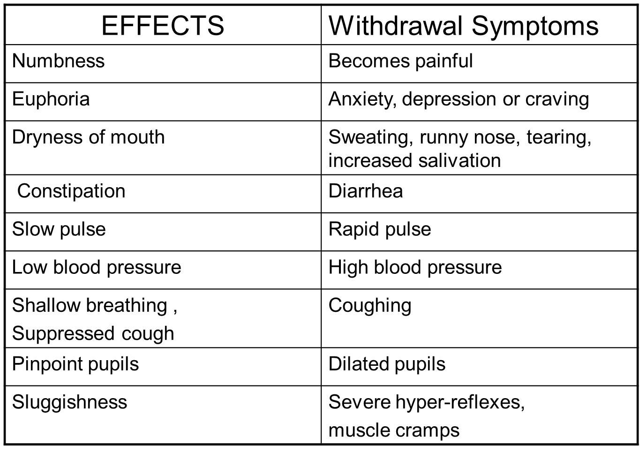
OPIOD Effects Vs Withdrawal
Methamphetamine
Effects Vs Withdrawal
Meth Effects | Meth Withdrawal
High Energy | Fatigue
Anxiety | Anxious
Euphoria | Depression
Full Body Stimulation | Nausea
Sweating | Cold and hot Body Temp
Rapid Pulse | Intense Cravings
High Blood Pressure | Painful Headaches
Dilated Pupils | Increased appetite
Muscle cramps | Lethargy
Aggression
Confusion
Delusions

Slide 27
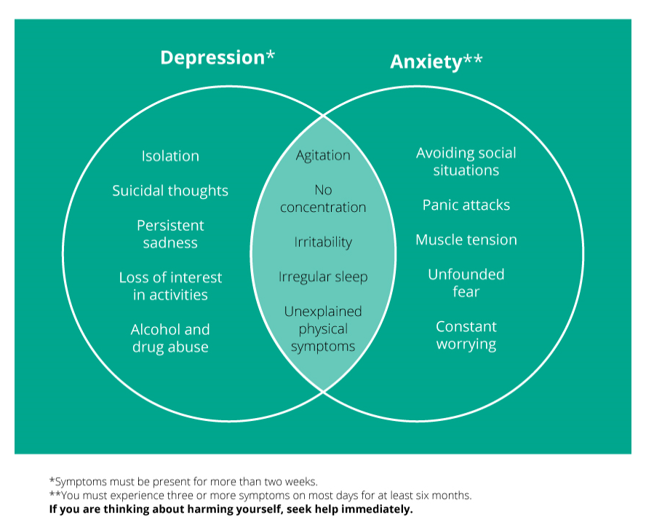
Clinical Symptoms
Absent of Drug/Alcohol Use

Slide 28
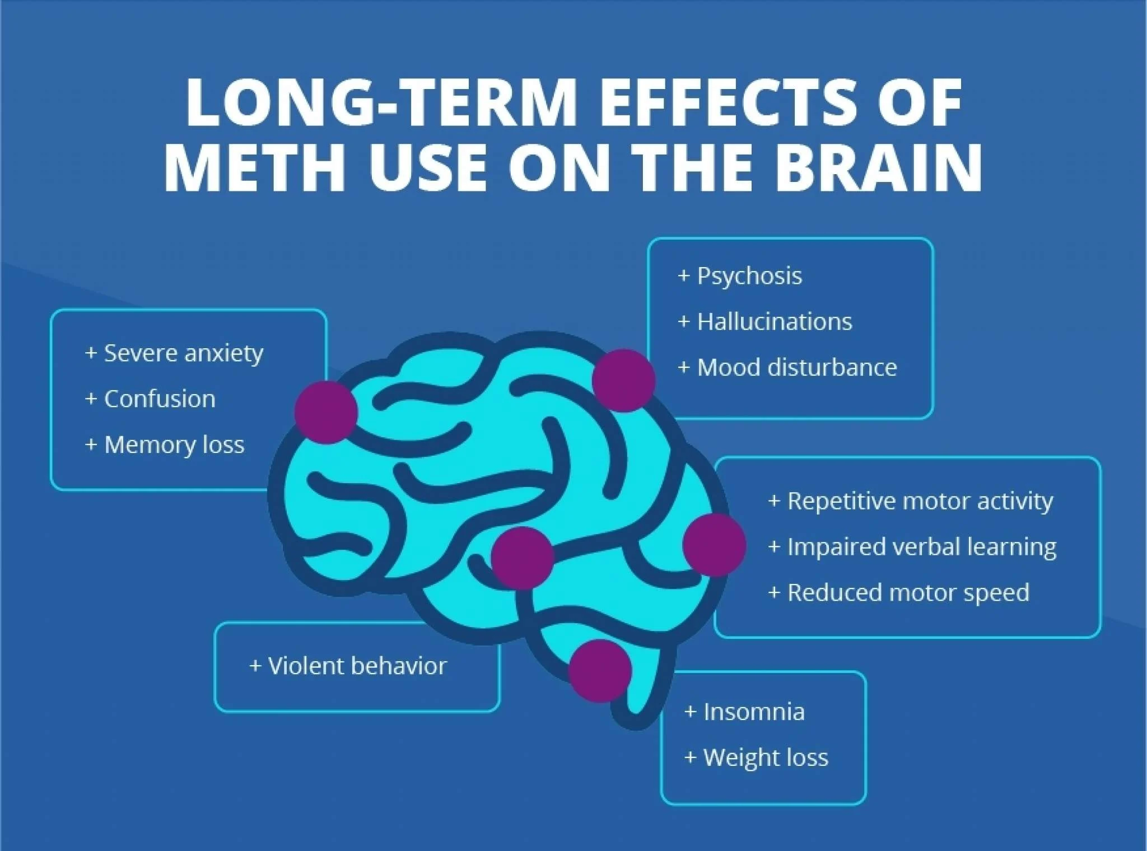
Methamphetamines and Stimulants
Includes (Adderall & other Uppers)

Slide 29
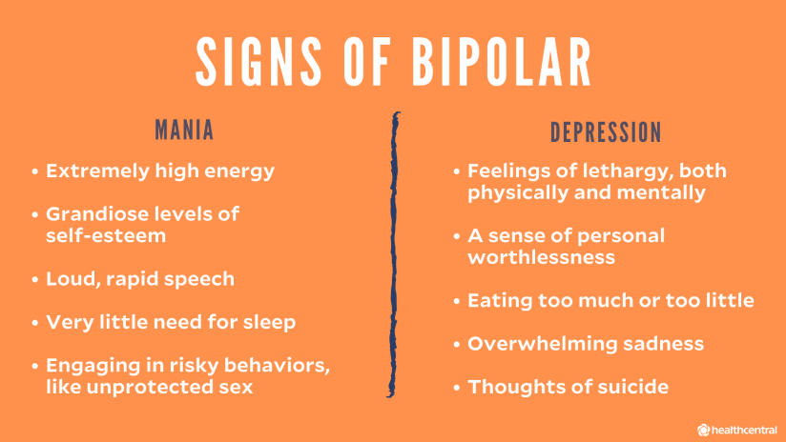
General BiPolar Symptoms

Slide 30
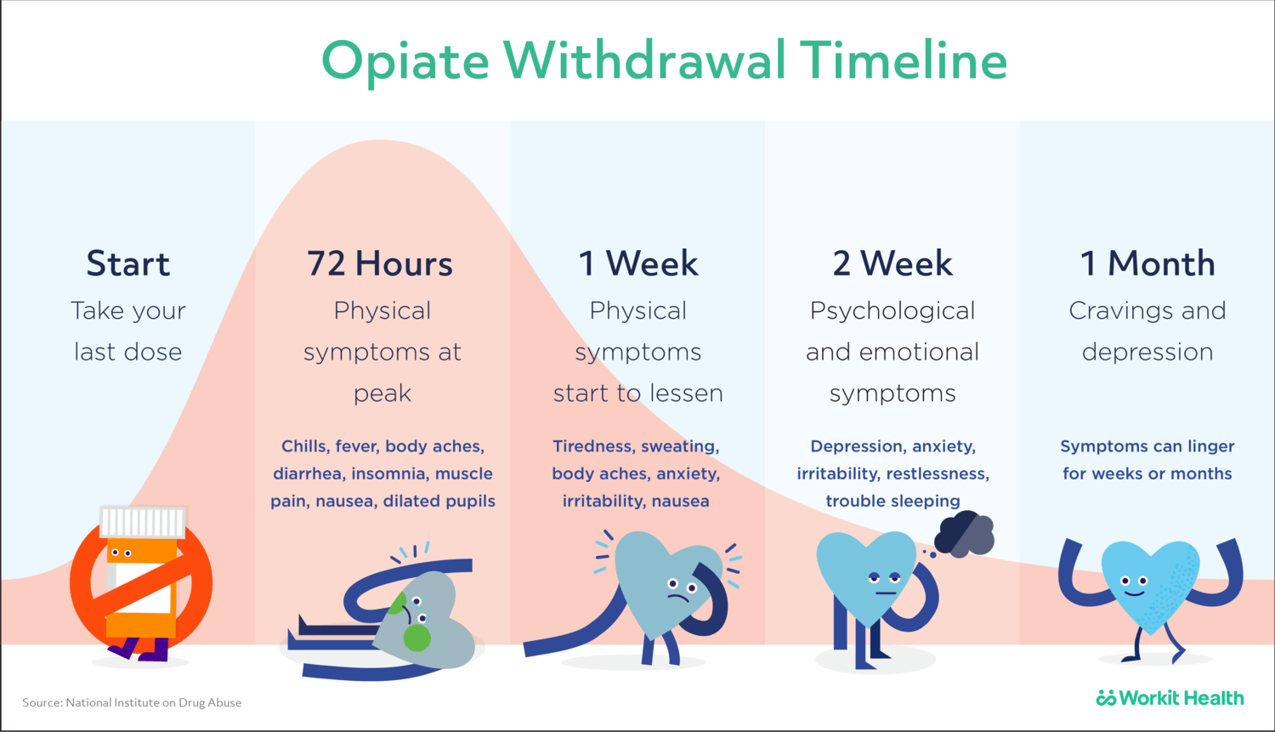

Slide 31
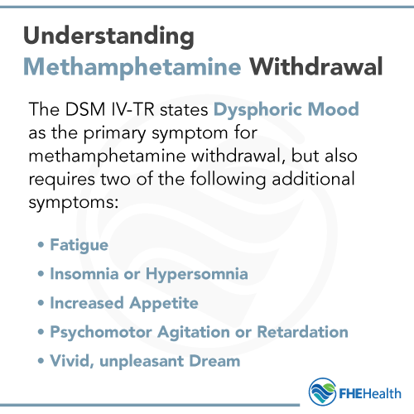
Methamphetamine Withdrawal

Slide 32
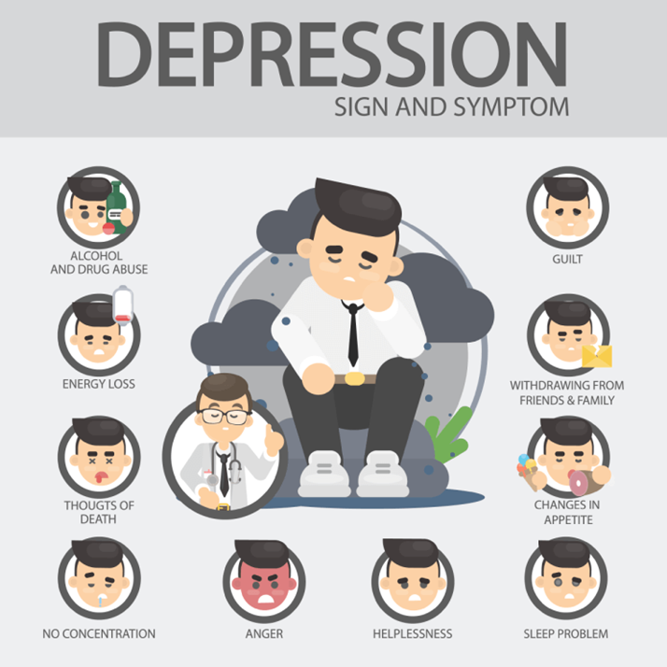
Depression symptoms (DSM V)
Symptoms need to be
Consistent over 2 weeks or more (not one single good day in that 2 weeks)
In absence of substance use or medication use
Absence of Situation
Worsening of symptoms
Physical pain is often associated with descriptions
Sadness or loss of interest
Sleeping too much or too little
Loss of appetite
Feelings of guilt that may be Unexplained
Loss of “normal” energy level
Decrease in ability to concentrate & memory
Changes in mood daily behavior, or
Loss of self-esteem
Chronic Fatigue
Unexplained aches and pains
Isolation
Moving more slowly
Neglecting responsibilities
Agitated and unsettled
Depression can also be associated with thoughts of suicide.

Slide 33
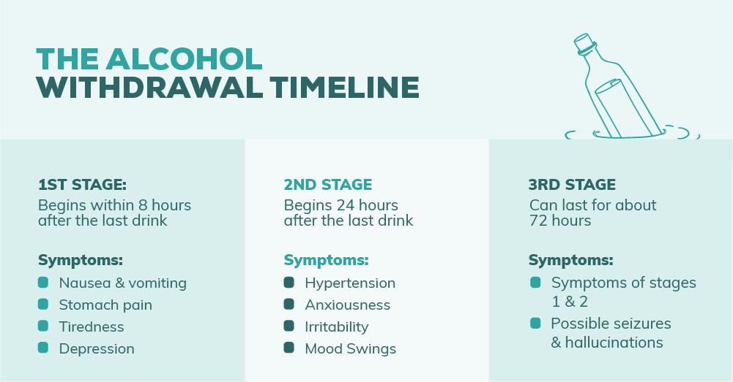
Alcohol (almost always present with drug use)
Mild Symptoms
Shakiness
Tired
Depression
Brain Fog
Anxiety
Irritability
Mood Swings
Sleep disturbances

Slide 34
Bipolar (DSM V)
Bipolar disorder, also known as manic depression, is a mental illness that brings severe high and low moods and changes in sleep, energy, thinking, and behavior.
People who have bipolar disorder can have periods in which they feel overly happy and energized and other periods of feeling very sad, hopeless, and sluggish
Unusual shifts in mood, energy, activity levels, concentration, and the ability to carry out day-to-day tasks.

Slide 35
People having a manic episode may: | People having a depressive episode may:
Feel very “up,” “high,” elated, or irritable or touchy | Feel very sad, “down,” empty, worried, or hopeless
Feel “jumpy” or “wired” | Feel slowed down or restless
Have a decreased need for sleep | Have trouble falling asleep, wake up too early, or sleep too much
Have a loss of appetite | Experience increased appetite and weight gain
Talk very fast about a lot of different things | Talk very slowly, feel like they have nothing to say, forget a lot
Feel like their thoughts are racing | Have trouble concentrating or making decisions
Think they can do a lot of things at once | Feel unable to do even simple things
Do risky things that show poor judgment, such as eat and drink excessively, spend or give away a lot of money, or have reckless sex | Have little interest in almost all activities, a decreased or absent sex drive, or an inability to experience pleasure (“anhedonia”)
Feel like they are unusually important, talented, or powerful | Feel hopeless or worthless, think about death or suicide

Slide 36
BiPolar Types
Criteria in General
Bipolar II Disorder— defined by a pattern of depressive episodes and hypomanic episodes, but not the full-blown manic episodes that are typical of Bipolar I Disorder.
Bipolar I Disorder— defined by manic episodes that last at least 7 days, or by manic symptoms that are so severe that the person needs immediate hospital care.
Usually, depressive episodes occur as well, typically lasting at least 2 weeks. Episodes of depression with mixed features (having depressive symptoms and manic symptoms at the same time) are also possible.
Cyclothymic Disorder (also called Cyclothymia)— defined by periods of hypomanic symptoms as well as periods of depressive symptoms lasting for at least 2 years (1 year in children and adolescents). However, the symptoms do not meet the diagnostic requirements for a hypomanic episode and a depressive episode

Slide 37

Anxiety (DSM V)
Common anxiety signs and symptoms include:
Feeling nervous, restless or tense.
Having a sense of impending danger, panic or doom.
Having an increased heart rate.
Breathing rapidly (hyperventilation)
Sweating.
Trembling.
Feeling weak or tired.
Trouble concentrating or thinking about anything other than the present worry.

Slide 38
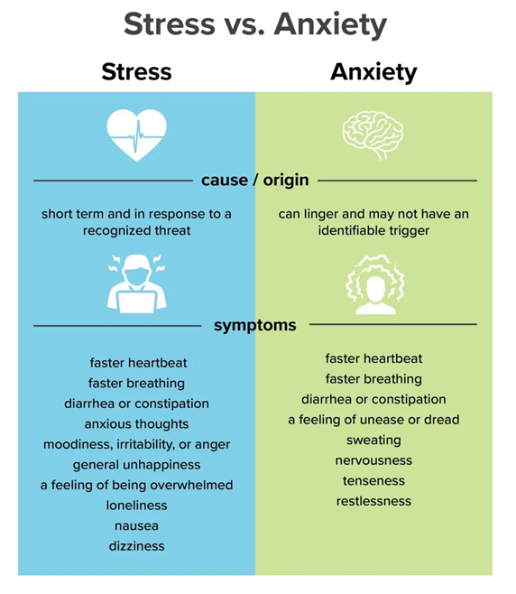
Common anxiety signs and symptoms include:
Feeling nervous, restless or tense.
Having a sense of impending danger, panic or doom.
Having an increased heart rate.
Breathing rapidly (hyperventilation)
Sweating.
Trembling.
Feeling weak or tired.
Trouble concentrating or thinking about anything other than the present worry.

Slide 39
Generalized Anxiety Disorder (GAD)
Persistent worrying or anxiety about a number of areas that are out of proportion to the impact of the events
Overthinking plans and solutions to all possible worst-case outcomes
Perceiving situations and events as threatening, even when they aren't
Difficulty handling uncertainty
Indecisiveness and fear of making the wrong decision
Inability to set aside or let go of a worry
Inability to relax, feeling restless, and feeling keyed up or on edge
Difficulty concentrating, or the feeling that your mind "goes blank"
Physical signs and symptoms may include:
Fatigue
Trouble sleeping
Muscle tension or muscle aches
Trembling, feeling twitchy
Nervousness or being easily startled
Sweating
Nausea, diarrhea or irritable bowel syndrome
Irritability

Slide 40
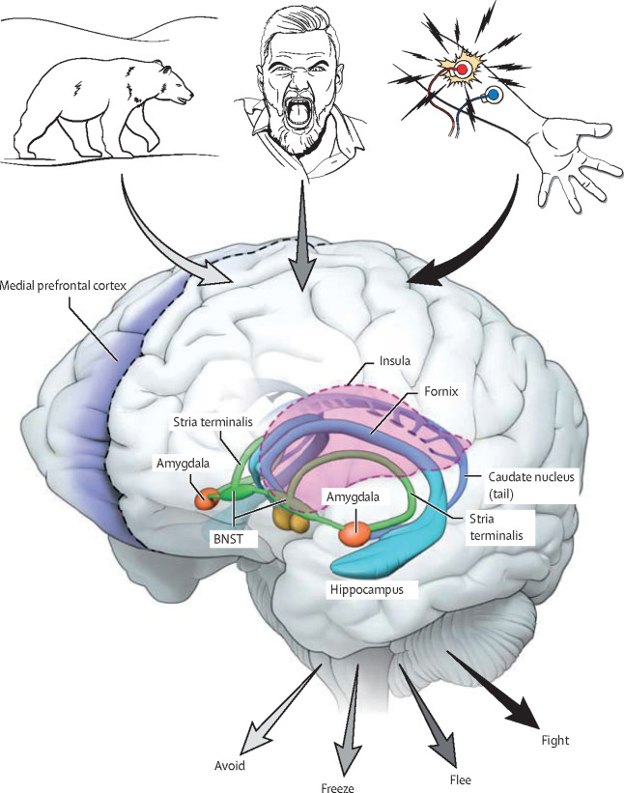
How Anxiety Feels
Activation of Fight or Flight physiological response
Avoid
Freeze
Flee
Fight
Staying in this state creates all kinds of neurological scenarios and can exacerbate the person’s ability to handle any stress or create such baseline for stress tolerance that nothing ignites the fight or flight response unless it is actually life threatening

Slide 41
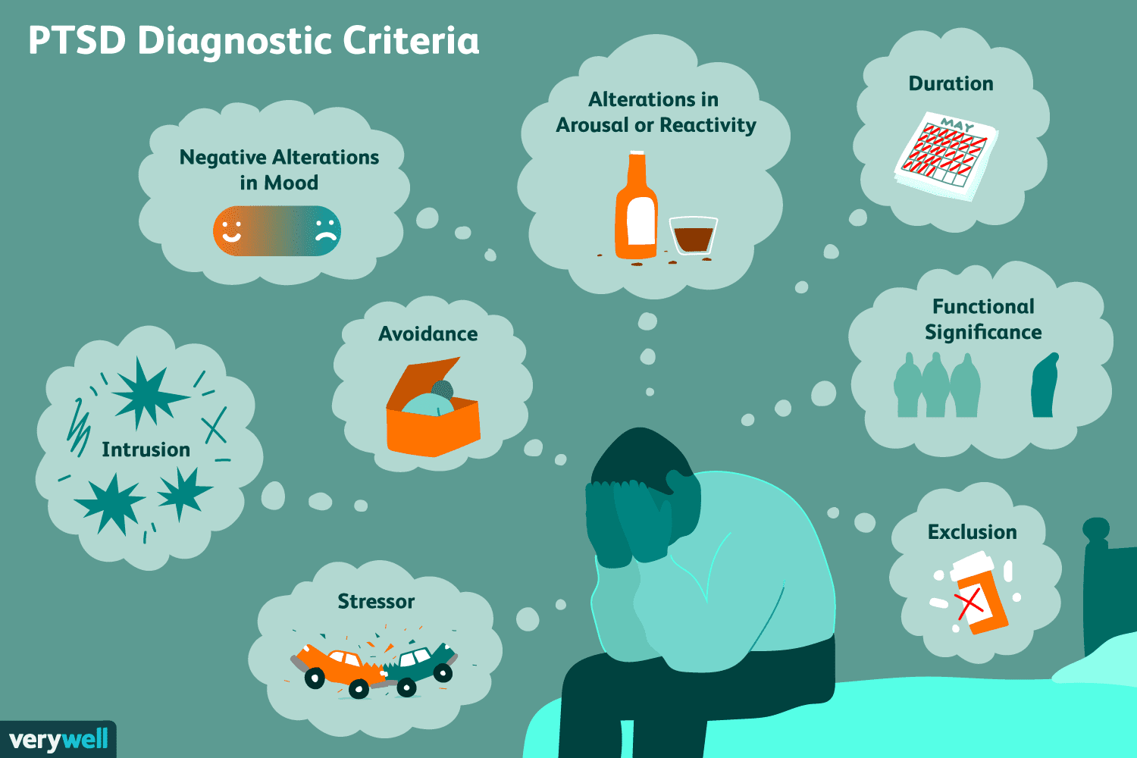
PTSD Criteria

Slide 42
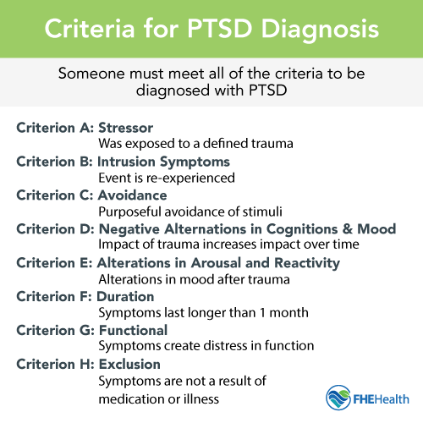
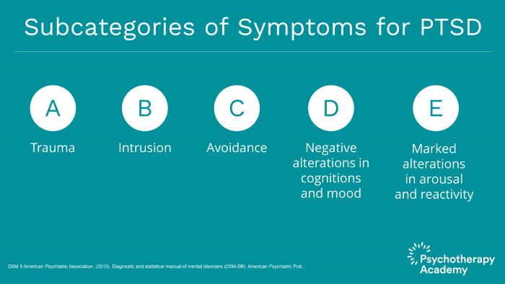
PTSD Criteria

Slide 43
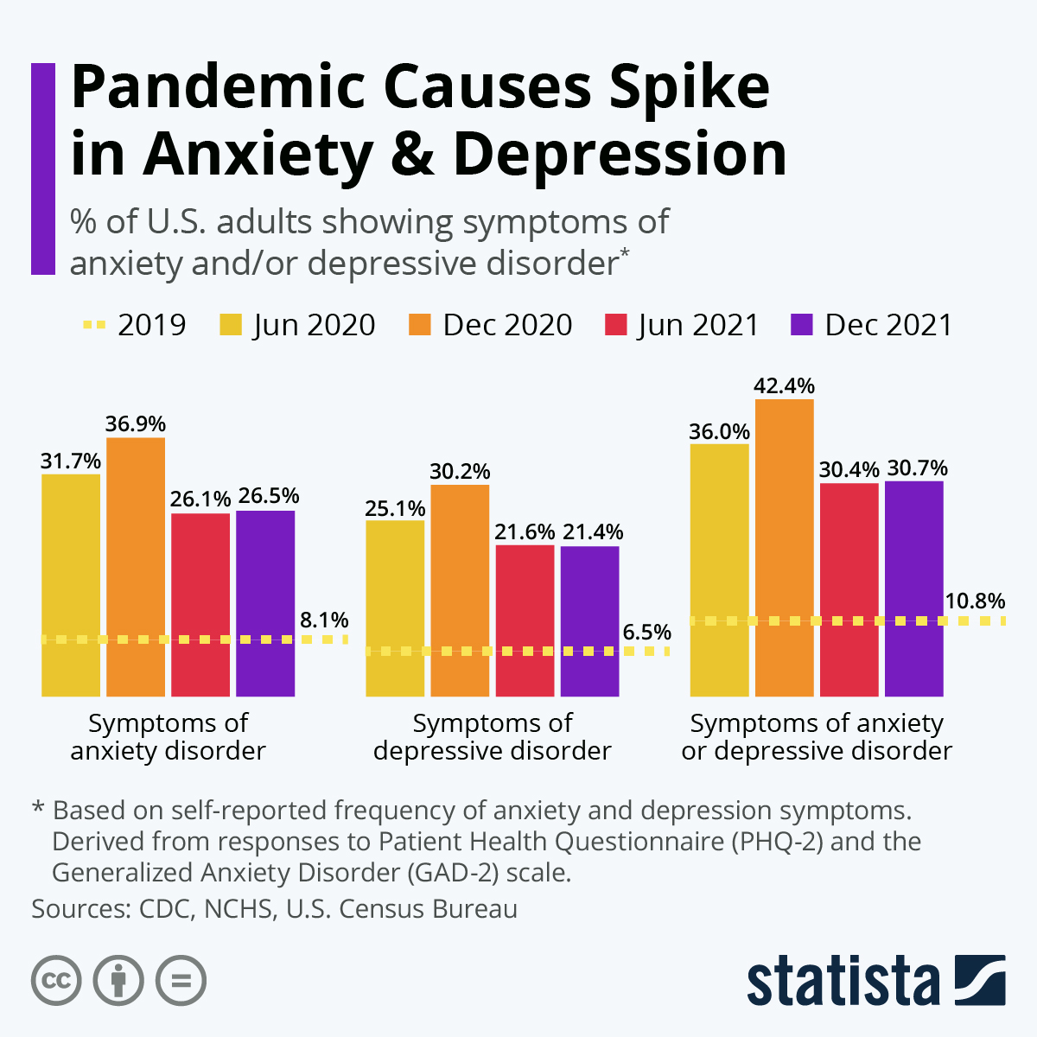
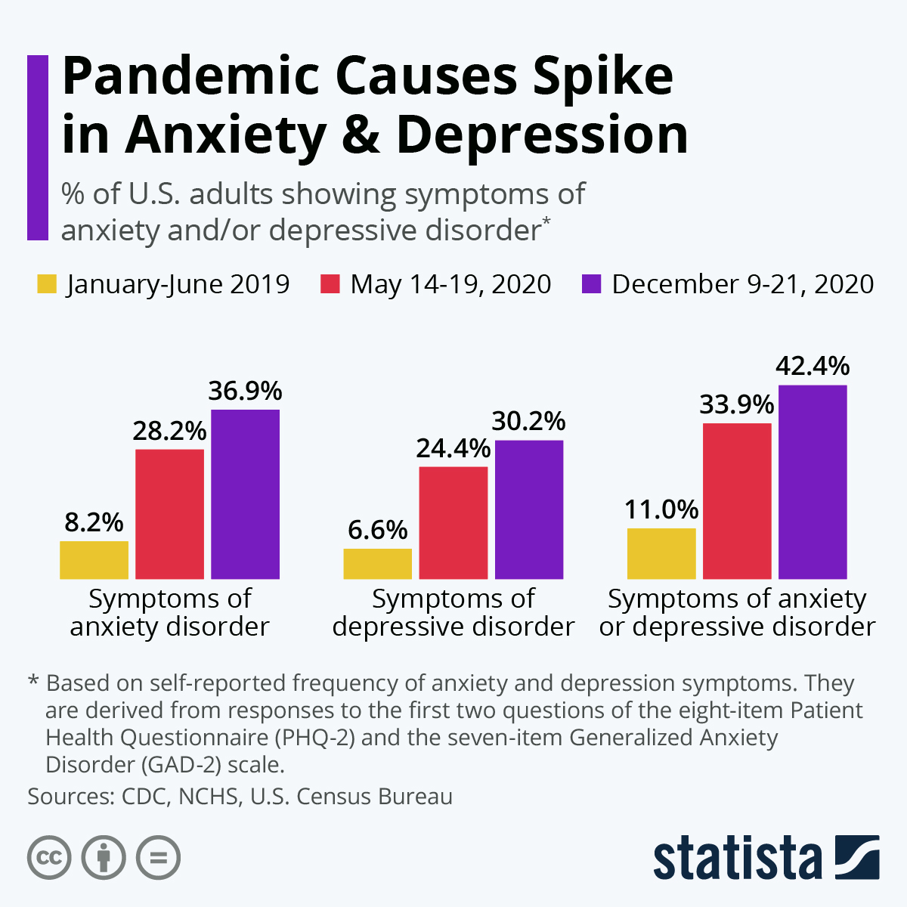
Pandemic and Anxiety

Slide 44
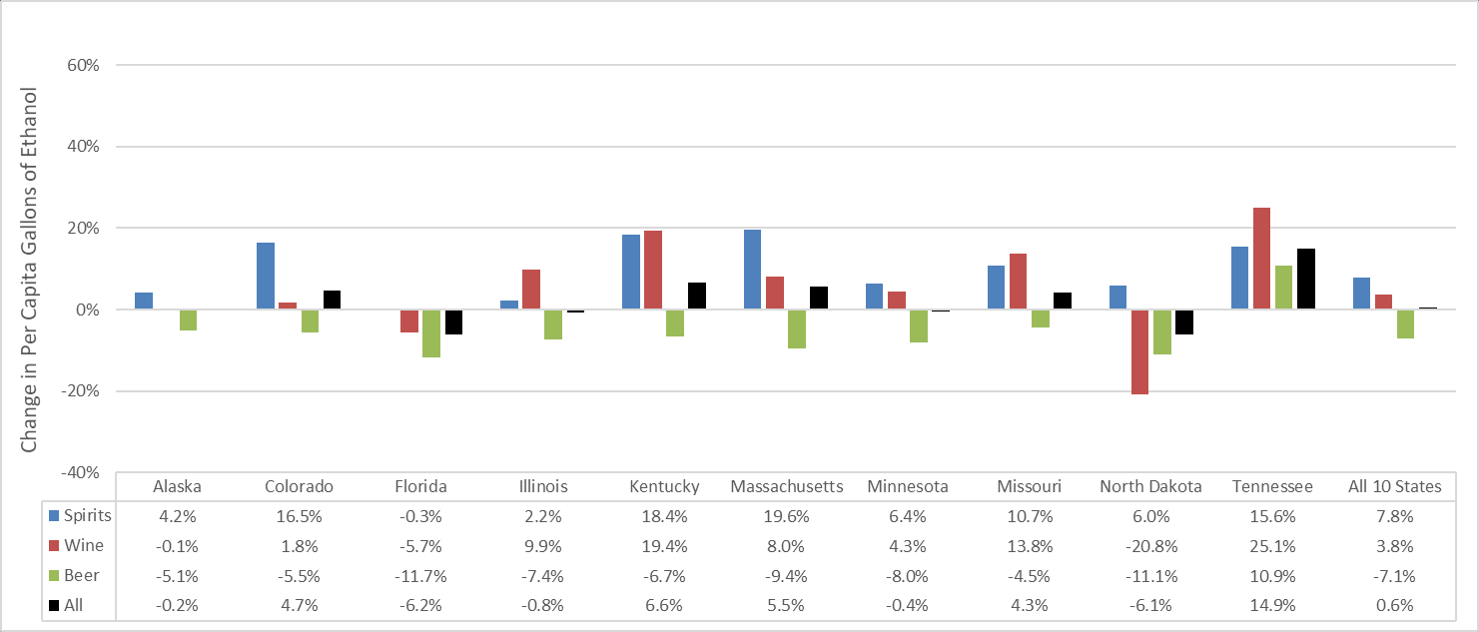
Alcohol Sales:
April 2020 compared to the prior 3-year April average (i.e., average of April 2017, 2018, and 2019) in states with data available as of March 4, 2021. (https://pubs.niaaa.nih.gov/publications/surveillance-covid-19/COVSALES.htm)

Slide 45
Scary Variables
Paranoia, Delusions, bizarre behavior
  Kratom
  Synthetic Cannabinoids
  No Ecstasy on street
  Fentyal & Meth in EVERYTHING
    Adderall pills, marijuana, meth, kratom – all tested positive for Fentyal within last 30 days at WRC.
  Pill Presses and counterfeit drugs
    Benadryl, powder other Non drug ingredients
Reports that addiction “feels stronger”
Reports of different withdrawal symptoms
  NO wonder I feel terrible I was taking Fentyal !!

Slide 46
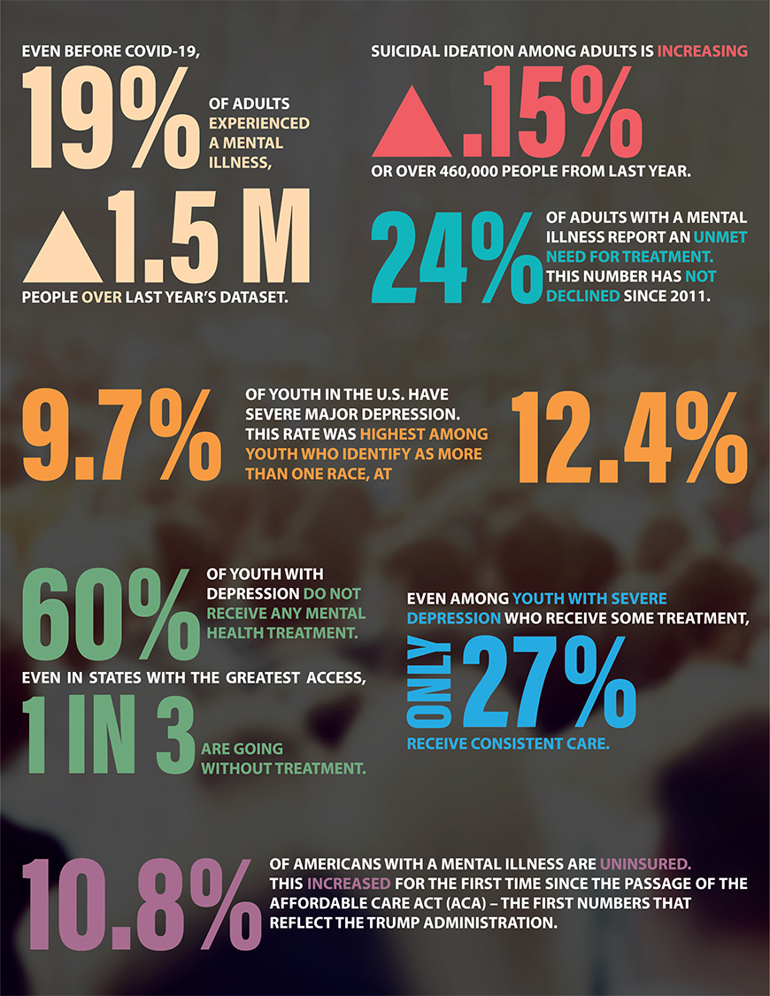
More Stats Since
COVID-19
(NAMI)

Slide 47
What are the Set Levels of Care per ASAM / TDI / JC / State ?
A person enters Treatment based on Diagnosis
Then matched to the Level of care…often questioned due to different information, or difficult to determine accuracy due to self report
The level of care a person enters will ultimately affect their chances of getting the proper care at the proper level of intensity and with the proper clinical or medical team.
A lot of DDX clients get lost in outpatient settings because they didn’t go to residential first, or didn’t go to a residential that is able to assess and diagnose the MH issues when they arise within the first 2-3 weeks of sobriety.

Slide 48
ASAM and Levels of Care
ASAM Level of Care | Common Name of Level of Care | Standard Time | DSM Diagnosis For Admission
0.5 | Prevention |  | SUD - Mild
1 | Outpatient or Supportive Outpatient | 30-60 Days 1 -8 Hours weekly | SUD - Mild/Moderate
2.1 | Intensive Outpatient (IOP) | 30 days 9 hours weekly | SUD - Mild/Moderate In some circumstances Severe if Substances with No risk for withdrawal and not Daily heavy use
2.5 | Day Treatment/PHP | 2-3 weeks 18 Hours weekly | SUD - Moderate/ Severe
3.1 | Residential Clinically Managed Low Intensity | 30 days 24 hours a day | SUD - Severe
3.3 | Residential Clinically Managed Population-specific High-intensity | 30 days 24 hours a day | SUD - Severe
3.5 | Residential Clinically Managed Population-specific High-intensity | 30 days 24 hours a day | SUD - Severe
3.7 | Detox Medically Monitored Intensive Inpatient Services | 3-10 Days Per Admit Doc | SUD - Severe
4 | Detox Medically Managed Intensive Inpatient Services | 3-10 Days Per Admit Doc | SUD - Severe

Slide 49
Thank you for opportunity !
Questions?
karrington@woodlandsrecoverycenters.com
To reach Clinical Team at WRC or for Referrals
Office: 409-299-8555

